Slide 1
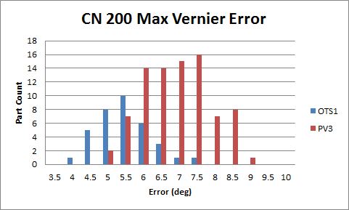
SGMW 200 Digital Position Sensor
Enhancements for Next Build (Week of April 14)
Allegro BC Chip – Significant Enhancement (Refer below)
Software update (dll & software release) …. Averaging
Probe Housing Shift of 1.0 mm (Location of Hall to Magnet)
A higher than expected vernier error (spur gear to hand wheel sensor) was seen on the SGMW 200 Hand wheel position sensor during the build last week. Additional tuning of the software associated with the calibration dll is taking place to minimize the issue.
May 7, 2014 Update
The higher than expected vernier error (spur gear to hand wheel sensor) associated with the SGMW 200 hand wheel position sensors was contributed to the Gain and Bias Current of the Allegro Hall sensor (BC chips). The team is working on a short term alternatives to for signal noise improvements and to enhance the yield:
Increase the Max Absolute Vernier Treshold Error (9.5 degrees => 10.0 degrees) based on simulation of the filtering taking place in controller . 10.0 + 4.5 (Temp. allocation) = 14.5 degrees Controller limit.
Potential programming of current chips built into probe housings - Allegro working on software (300 probe housings at Suzhou)
Re-Running the Probe Housings at the station
Expected Fallout :
Current Probe Housings ….. 4.9 %
Increase the Max Absolute Vernier Treshold Error (9.5 degrees => 10.0 degrees) ….. 4.9 % => 2.0%
Programming Change to Hall Chip ….. 2.0% => < 0.2%
Production Build Schedule:
830 – Week of May 12
1600 – Week of May 19
Shipment Schedule to Kimball (Must be improved):
900 chips (450 PH) - May 12
4,000 chips (2,000 PH) - May 19
4,000 chips (2,000 PH) - May 26

